Slide 1
Predicting Credit Card Approval
Renjini Balachandran
College of Science, Engineering, & Technology,
Grand Canyon University
Capstone Project
September 2023

Slide 2
Scope of the Project
One of the biggest revenue streams of any banking or financial institution would be from the interest charged from the lending.
Banks should face the greatest credit risk in the fullness of their loaning. There are various loaning products the banks are offering to the customers. However, Credit cards are one of the key loaning products any bank would ever have.
The project aims to develop a web application using a machine learning model to predict whether a credit card application will be approved or rejected.
By examining historical credit card application data, the model will evaluate an individual's creditworthiness and provide effective perceptions to financial institutions for making updated decisions about credit card approvals.

Slide 3
The primary objectives and focuses of this project are,
To improve the credit card approval process for a financial institution.
Identify the creditworthiness of applicants and minimize the risk of defaults and bad debts.
Reduce manual underwriting efforts, save time, and improve the efficiency of the approval process. Automation can help in faster decision-making and quicker responses to applicants.
Develop a credit card approval system that adheres to anti-discrimination laws and regulations to prevent biases and discrimination in credit decisions.
Improve customer satisfaction by providing timely and fair decisions. A positive experience can lead to customer loyalty and retention.
Develop models or mechanisms to identify and reject fraudulent credit card applications, which can lead to financial losses for the institution.

Slide 4
Design Summary of the Project
This project aims to create a predictive model that determines the approval likelihood of credit card applications.
The model will be designed to utilize historical credit application data, analyzing various applicant features like income, credit status, employment status, and more to predict if an application will be approved or denied.
Supervised Machine Learning algorithms like Logistic Regression and Random Forest are used in this project to create the model.
In this Python language is used to build a series of applications to retrieve, process, and visualize data. Sci-Kit-Learn, Numpy, and Pandas are the main libraries used in this project.

Slide 5
Design of the Project
Designing a credit card approval prediction project involves breaking it down into several phases, each with its own set of tasks and considerations.
Project Planning
Includes the project’s objectives, goals, and the scope.
Create a timeline with milestones and deadlines.
Data collection and preparation
Identify data sources and obtain historical credit card application data.
Preprocess the data
Handle missing values & Encode categorical variables.
Normalize or scale numerical features & Perform feature engineering.
Split the data into training and test sets.

Slide 6
Foundation of the Project
Exploratory Data Analysis (EDA)
Conduct EDA to gain insights into the dataset
Visualize data distributions.
Analyze correlations between features.
Identify potential outliers.
Explore the balance between approved and rejected applications.
4. Feature Selection
Use feature selection techniques like feature importance to identify relevant features for credit card approval prediction.

Slide 7
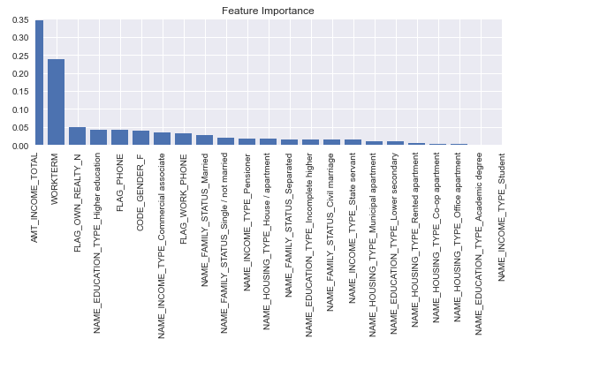
Feature Importance helps to identify which features or variables have the most influence on the model's predictions.

Slide 8
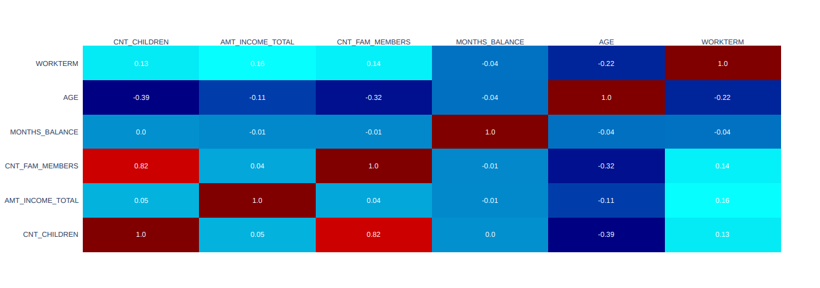
Correlation heatmaps are a type of plot that visualizes the strength of relationships between numerical variables. Correlation plots are used to understand which variables are related to each other and the strength of this relationship.

Slide 9
Model Selection and Development
Choose appropriate machine learning algorithms, Logistic Regression, and Random Forest for classification.
Develop models for both algorithms for comparison.
Perform hyperparameter tuning using the validation set.
Assess the models' performance using various evaluation metrics.
6. Evaluation and Metrics
Define evaluation metrics that align with the project's goals, such as accuracy, precision, recall, F1-score, or ROC AUC.
Establish a clear evaluation plan, including how the model will be tested and validated.

Slide 10
Findings of the Project
7. Evaluation Results
Logistic Regression and Random Forest are the two predictive models that were implemented.
Performance measures were tested by using Accuracy, Precision, Recall, and AUC on each classifier.
For Logistic Regression,
Accuracy Score is 0.61
F1 Score is 0.599
Precision Score is 0.596
Recall Score is 0.601

Slide 11
Evaluation Results
For Random Forest
Accuracy Score is 0.90098
F1 Score is 0.8999
Precision Score is 0.88155
Recall Score is 0.91903
Here, I evaluated two classifiers and observed that Random Forest performed better than Logistic Regression.
I have achieved a high accuracy level and by considering that usage of this model in the real world can be applicable. Also, this model is used for the deployment.

Slide 12
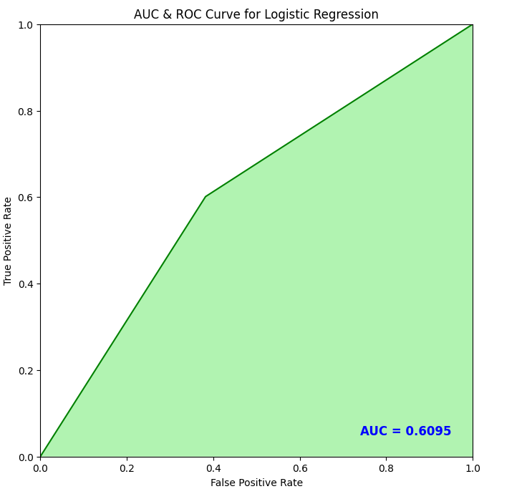
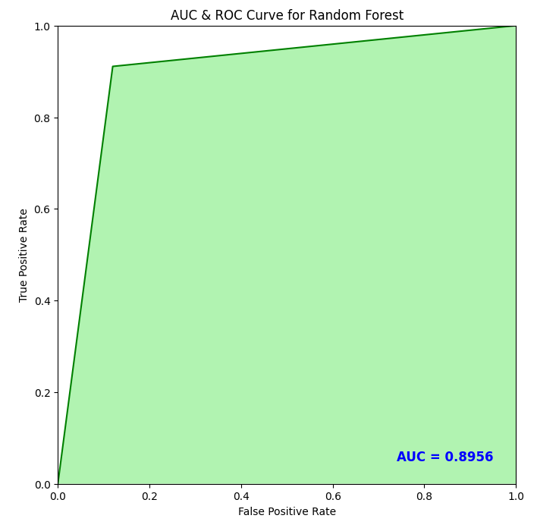

Slide 13
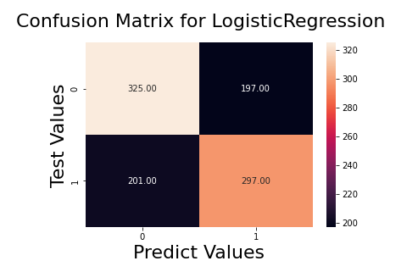
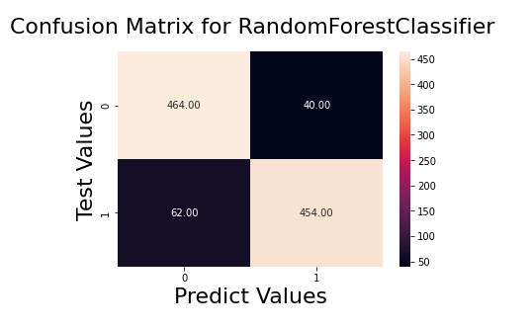

Slide 14
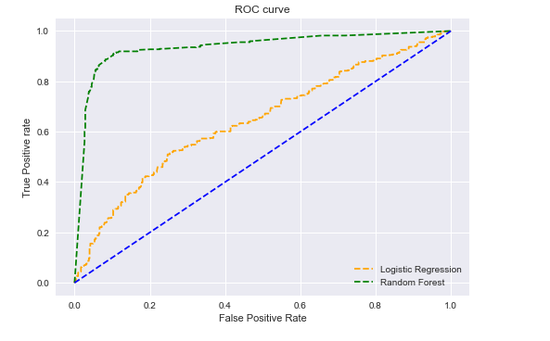
ROC Curve showing the comparison of both Logistic Regression & Random Forest

Slide 15
Outcomes of the Project
7. Model Deployment
Saved the Random Forest model file and the final one for the deployment.
Checked in the file to the Git Repository.
Using the model file created a streamlit user interface application in Python for credit card approval.
Deployed this application in the streamlit cloud.
Tested the application
These are the main links of my capstone project.
Streamlit application URL - https://masterscapstone-4s8mhgeemfxqxa9t4xxjdz.streamlit.app/
Git repository URL - https://github.com/brenjini/masters_capstone

Slide 16
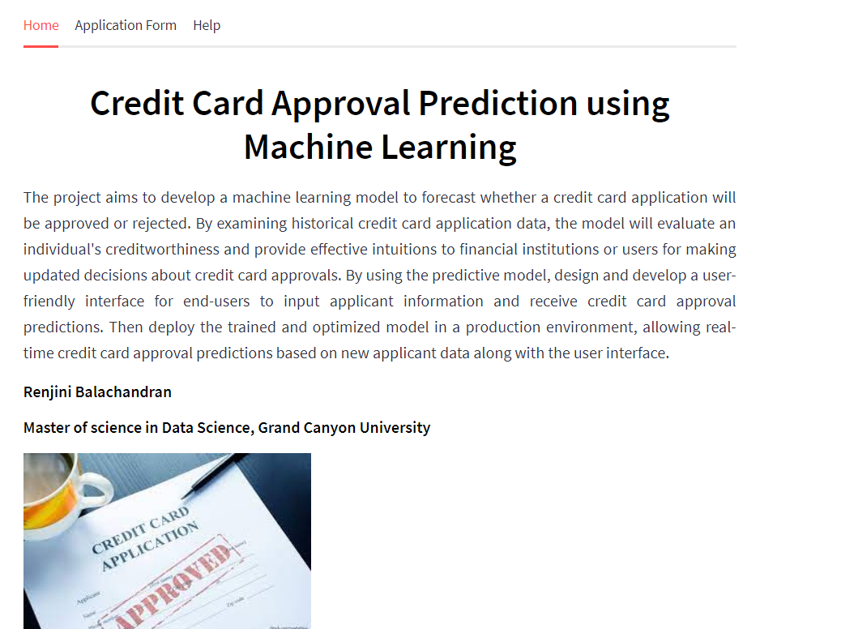
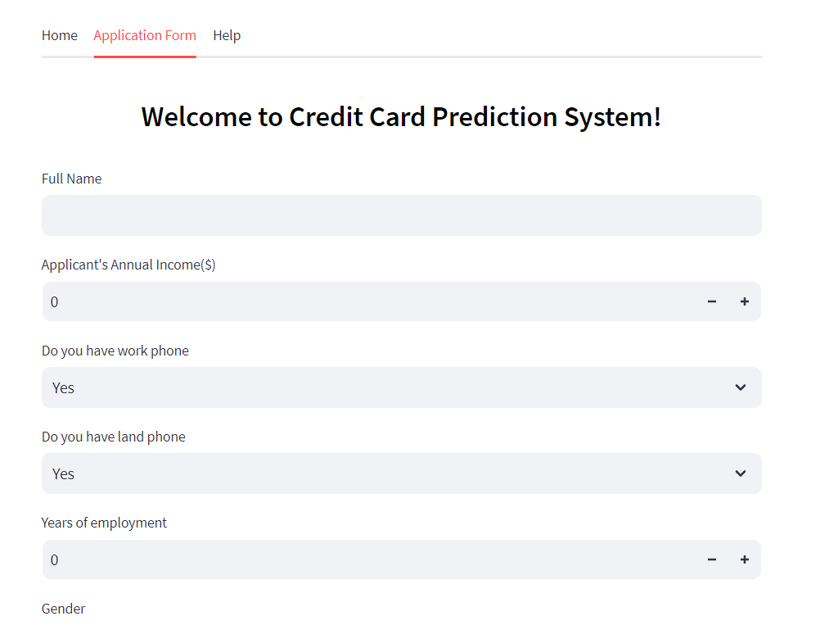
Application User Interface

Slide 17
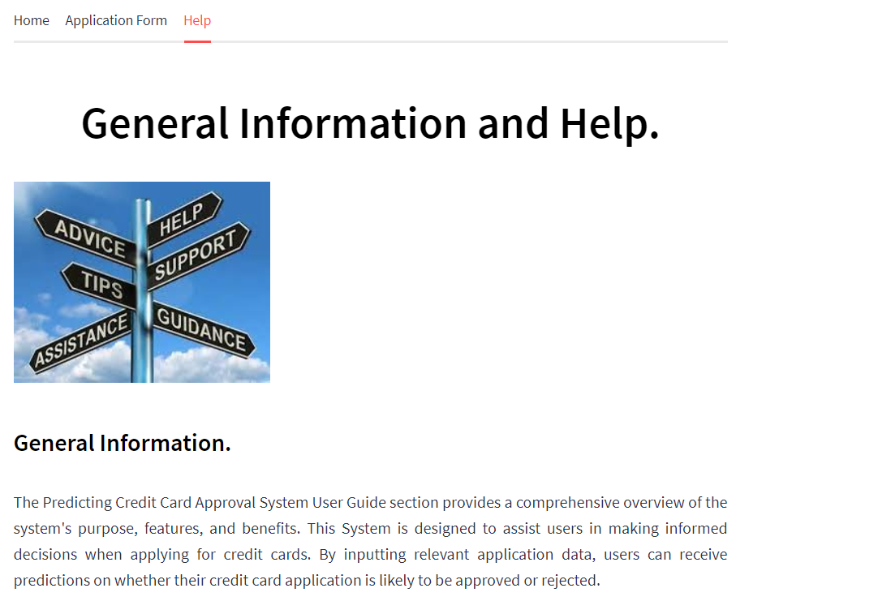
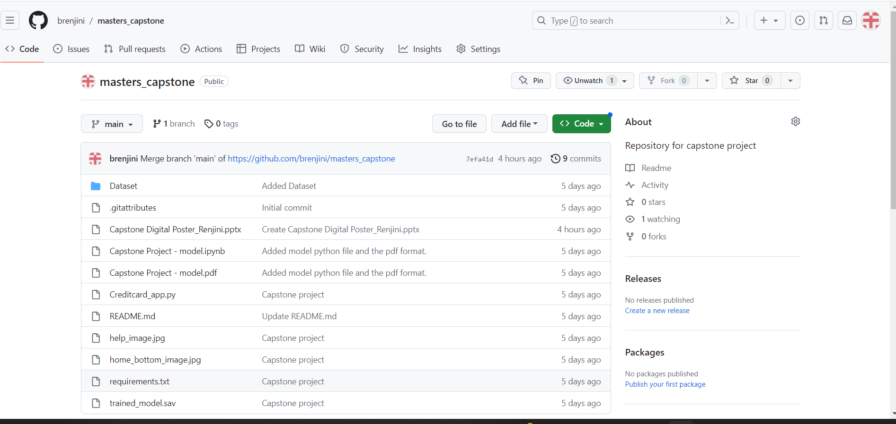
Application User Interface
Git Repository

Slide 18
Implications of the Project
Improved Decision-Making: The project can lead to more informed and data-driven credit card approval decisions, helping financial institutions better manage risk.
Risk Mitigation: By accurately predicting credit card approval outcomes, the project can assist in identifying and mitigating potential risks associated with lending, such as default rates and bad debt.
Customer Experience: The project can impact the experience of credit card applicants. A well-designed system can provide quick and fair decisions, improving customer satisfaction.
Reduced Human Error: Automation reduces the likelihood of human errors in the credit card approval process, which can have financial and reputational consequences.
Business Impact: The project's success can have a significant impact on the business, affecting revenue, profitability, and market competitiveness.
Feedback Mechanisms: Establishing feedback mechanisms for both users and the model itself is essential for continuous improvement.

Slide 19
References
Arokiaraj Christian St Hubert, R. Vimalesh, M. Ranjith, S. Aravind Raj (2020, April.) Predicting Credit Card Approval of Customers Through Customer Profiling using Machine Learning. https://www.ijeat.org/wp-content/uploads/papers/v9i4/D7293049420.pdf
FIGI. Big data, machine learning, consumer protection and privacy. https://figi.itu.int/wp-content/uploads/2021/04/Big-data-Machine-learning-Consumer-protection-and-Privacy_f-1.pdf
Grand Canyon University. Capstone Project Handbook: Masters of Science in Computer Science or Data Science https://www.gcumedia.com/lms-resources/student-success-center-content/documents/cset/masters-ds-cs-capstone-project-handbook.pdf
Sangal, A. (2022, January 11.) Predicting Credit Card Approvals using Machine Learning. https://medium.com/@amansangal9/predicting-credit-card-approvals-8409c5280f91
Thomas J. Catalano, Bloomenthal. A, (2023, May 6.). Credit Card: What It Is, How It Works, and How to Get One. URL https://www.investopedia.com/terms/c/creditcard.asp (accessed 12.10.20).

